Slide 1
Machine Learning for Computer Systems
Nick Feamster University of Chicago

Slide 2
Layering and TLS Protocol
Layers
Protocols
TLS
Application
TLS
SSH
RTP
TLS
Transport
TCP
UDP
QUIC
Internet
IP
ICMP
Link
Ethernet
Wi-Fi
MAC
Notes:
To start off, I’d like to show a brief background of how the protocols on the internet are organized, using the TCP/IP model.
Here, four different layers provide separation between various protocols, that together, specify how data should be packetized, addressed, transmitted, routed, and received.
The TCP/IP model is standardized, and is maintained by the Internet Engineering Task force. However, it is typically up to individual vendors or users to correctly implement the protocols at any layer.
Examining possible errors or correctness of implementation using a Transformer model is the focus of my presentation today,
NEXT
specifically in the context of the Transport Layer Security, or TLS protocol

Slide 3



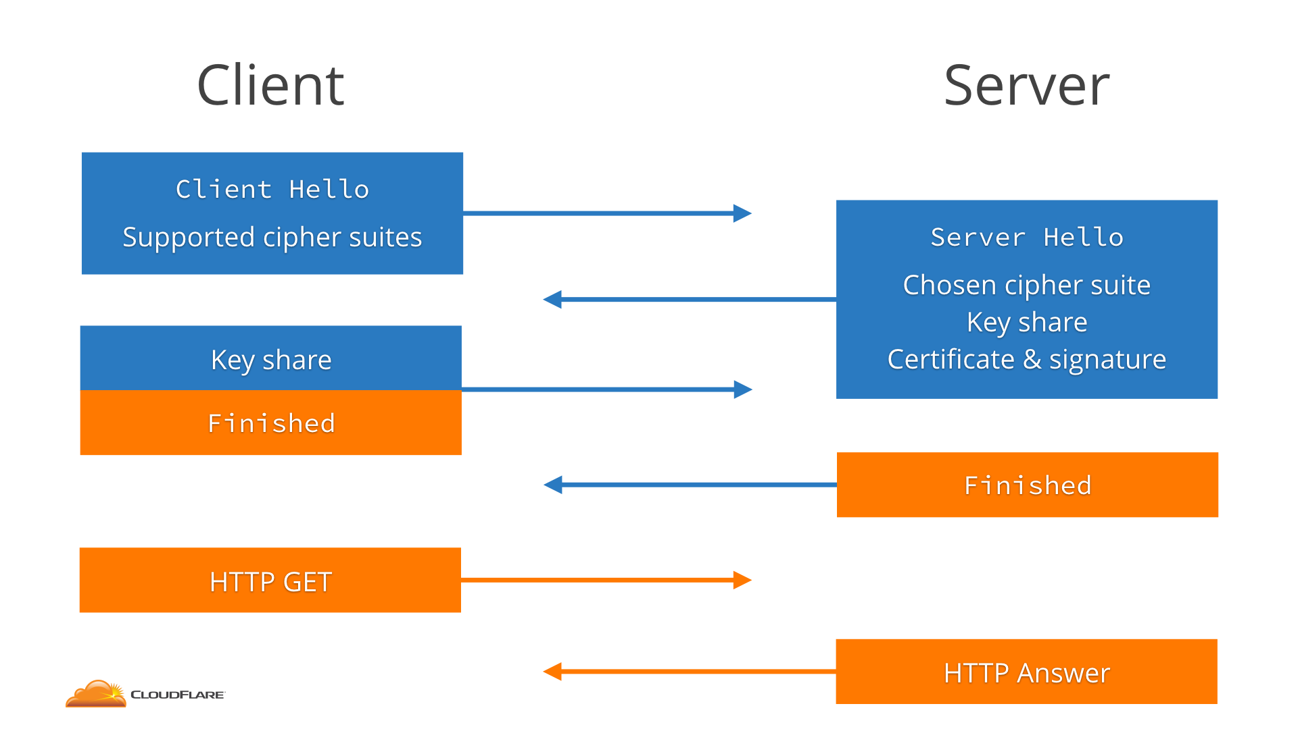
TLS looks simple…
References [1, 2]
Notes:
TLS is a large part of modern communication security and everyone uses it each day.
It ensures that the connection between say your computer and your banking website is encrypted, and that an eavesdropper can’t see the values for balances in your account that the bank sends to you.
The user or entity who hosts a website is responsible for correctly configuring the protocol.
At a high level, the idea and process behind TLS isn’t too complicated. When your web browser first connects to the server hosting a website, it makes the connection known to the server (client_hello) and tells the server which ciphersuites, or set of encryption algorithms it supports to perform encryption. The server then chooses one of the advertised cipher suites, and sends its choice, along with keys for the ciphersuite algorithms and its certificate back to your web browser (server_hello). Once both sides have verified that they’ve received all of these items to make the encryption/decryption on both sides work, they begin sharing data. This exchange or setup is called the “TLS Handshake”

Slide 4
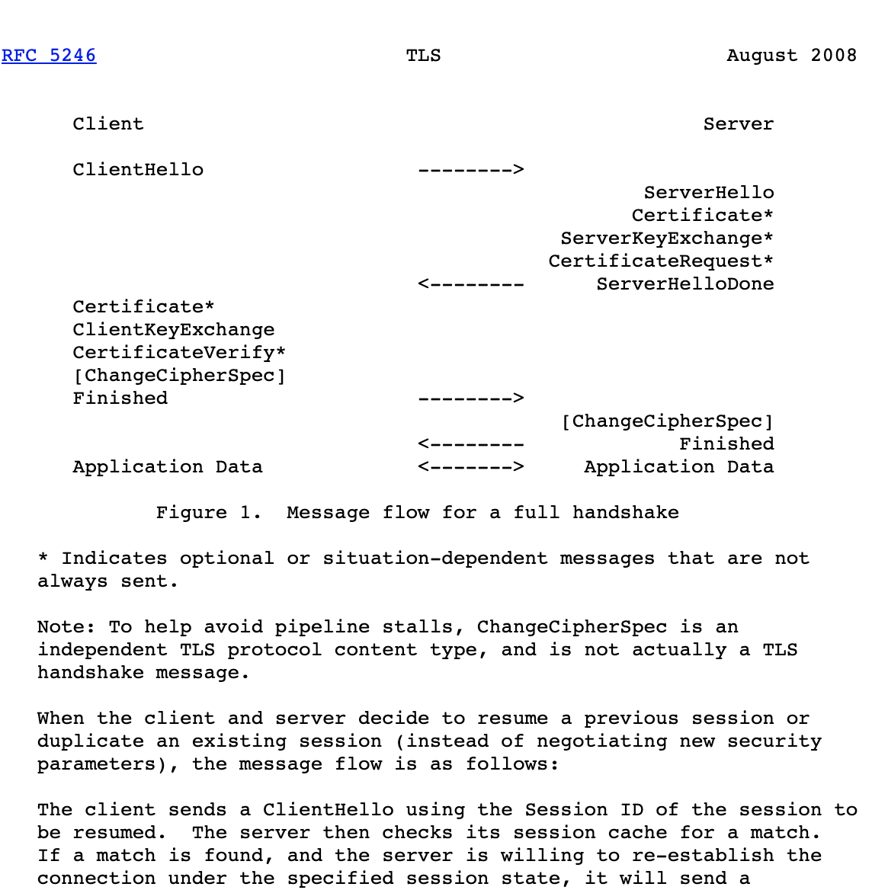
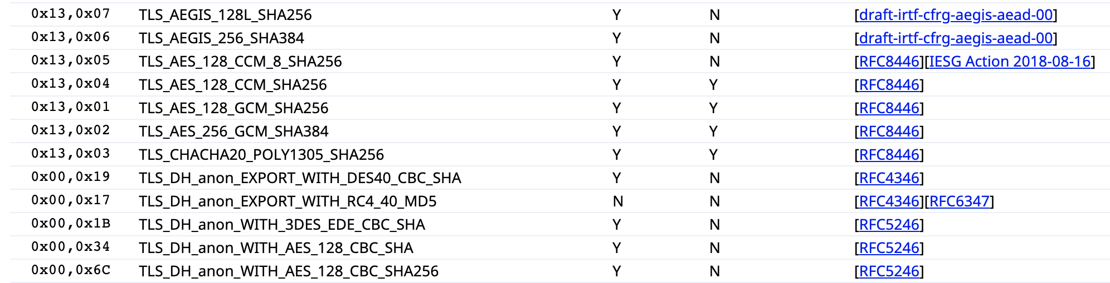

…But is Complicated to Configure
360 cryptographic ciphers
44 elliptic curves
40 protocol extensions
6 protocol versions
…..
19 fields to configure for
References [3]
Notes:
Now the problem with TLS, and at large, networking protocols in general, is that configuring them is very complicated.
Documentation for each protocol is specified in ever-updating versions of spec documents called a “Requests for Comments” or RFCs, published by the Internet Engineering Task force. These documents are essentially huge walls of plain-text (one example is in the slide), with no figures, or if there are figures, they also are made with plaintext.
NEXT
These spec documents are not only tedious to read given their format, but also incredibly long – for example there are 104 pages in the TLS version 1.2 spec document, the version of TLS most widely adopted today.
NEXT
Further, for each part of a protocol defined in the RFC, there are numerous possible configurations can be set – for example, here are the hexadecimal field values for ciphersuites you would reference if you wished to specify them in a TLS server configuration
NEXT
All in all, the space of possible settable values for all configurable items in the TLS protocol is huge. If you consider this across multiple revisions, and versions of a protocol it becomes overwhelming.

Slide 5


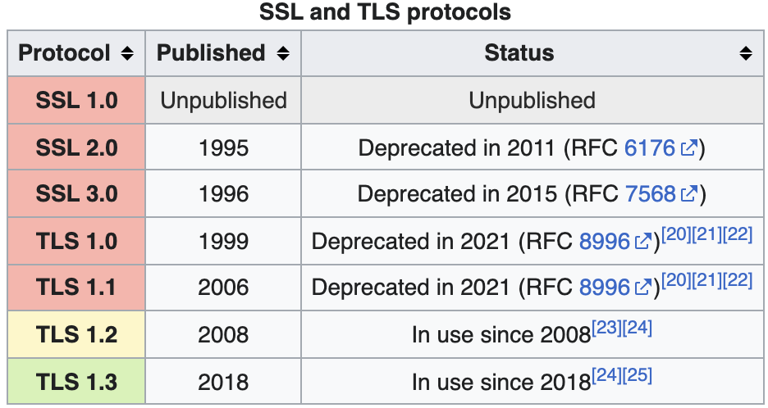

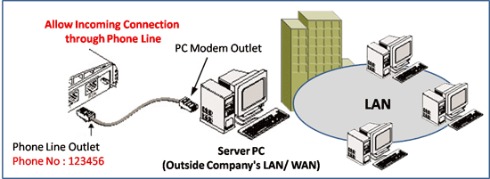
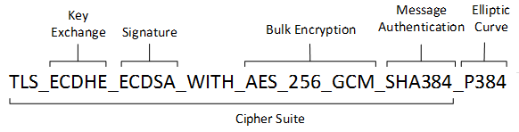
Reasons for Misconfiguration
Technical Reasons
Human Reasons
Weak ciphersuites
Obsolete hardware/software
Old protocol versions
Lack of knowledge
References [4, 5, 6, 7]
Notes:
Because of this, the networking community has acknowledged that configuring systems to support these protocols is a difficult task, and some services exist that can check for misconfigured settings in a website’s TLS configuration.
NEXT
In this project, I call these technical reasons. Technical reasons are the explicit reasons for misconfiguration verifiable in a website’s TLS server setup, such as
NEXT
using a weak ciphersuite – where in this picture if any algorithm in the ciphersuite is outdated or vulnerable, the ciphersuite should not be used, OR
NEXT
using an old protocol version vulnerable to attacks
NEXT
Outside of technical reasons, there are what I call in this work “human reasons for misconfiguration.” Human reasons are the non-explicit reasons behind the technical reason, or in other words, why some field was set the way it was, or why operator deployed a vulnerable configuration to begin with.
NEXT
For example, a human reason for misconfiguration may be that a system admin setup their TLS configurations using a manufacturer’s out-of-the-box suggested configuration, and never bothered to update this configuration, leading it to become misconfigured.
NEXT
Another example would be as simple as lack of knowledge – a user blindly following an online guide that contains errors in the configuration steps.
NEXT
If we think about either set of reasons in regard to how easy they are to investigate or research, we see that technical reasons are easy to verify – one can automate checking the fields communication from a website to see if the TLS related items are misconfigured.
Human reasons on the other hand are difficult, you cannot build a system that looks at the technical reason for misconfiguration, and decide why the operator included the reason for the misconfiguration.

Slide 6
Related Work – Simoiu et al.^{[8]}
We initially expected to find large clusters of sites using the same configurations… match[ed]... to online recommendation guides, Stack Overflow posts, blogs, server defaults…
Instead, we find a complex and fragmented ecosystem of HTTPS configurations....
Our attempts to cluster configurations were largely unsuccessful—there are simply a large number of unique, seemingly unrelated configurations deployed
Notes:
Some previous work tried to shed some light on these human reasons, using an empirical study where they evaluated technical misconfiguration reasons, along with the hardware configuration of misconfigured devices
NEXT
However, this empirical study found it was difficult to navigate this process
NEXT
And the results were not able to show any patterns in clustering misconfigurations by their human reason, or how these misconfigurations cluster at large.

Slide 7
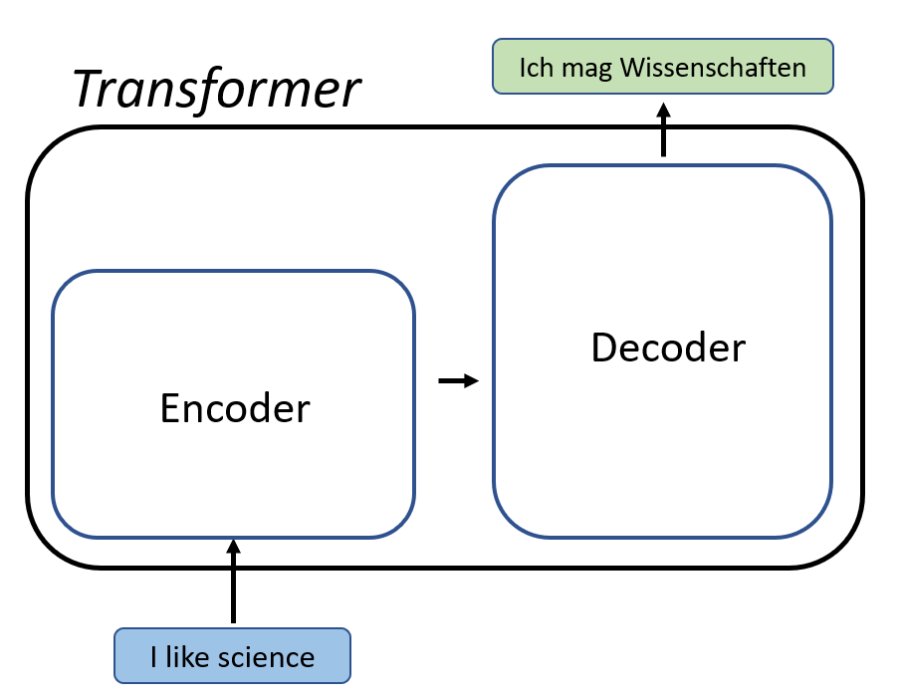
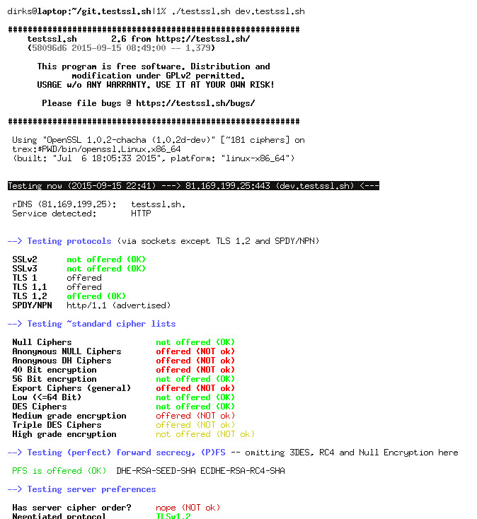
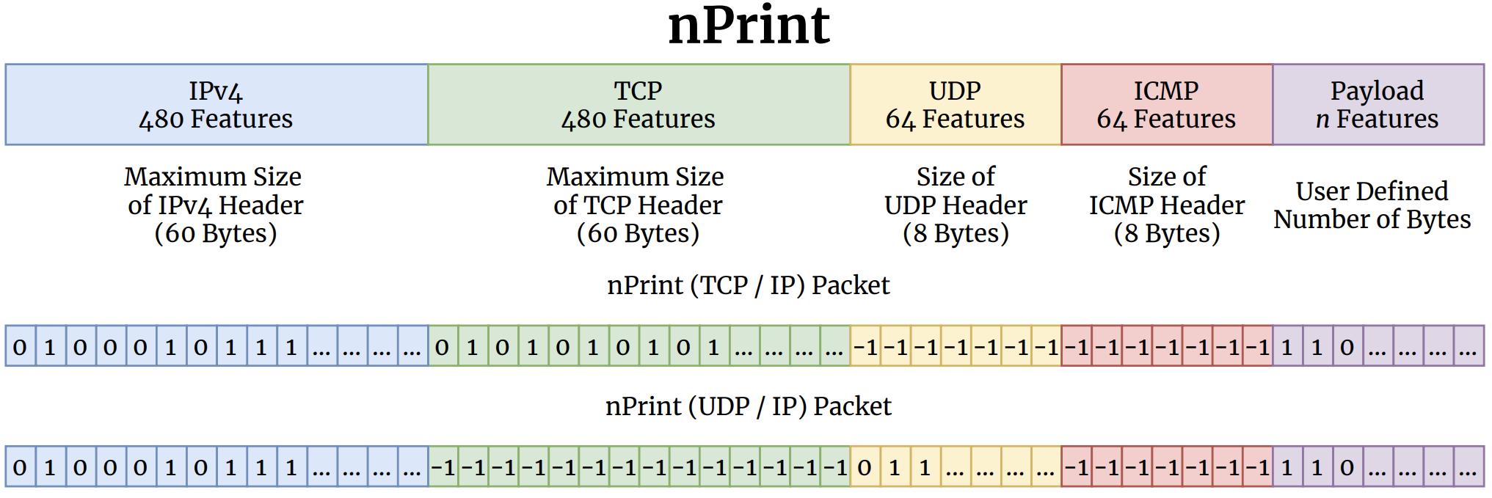
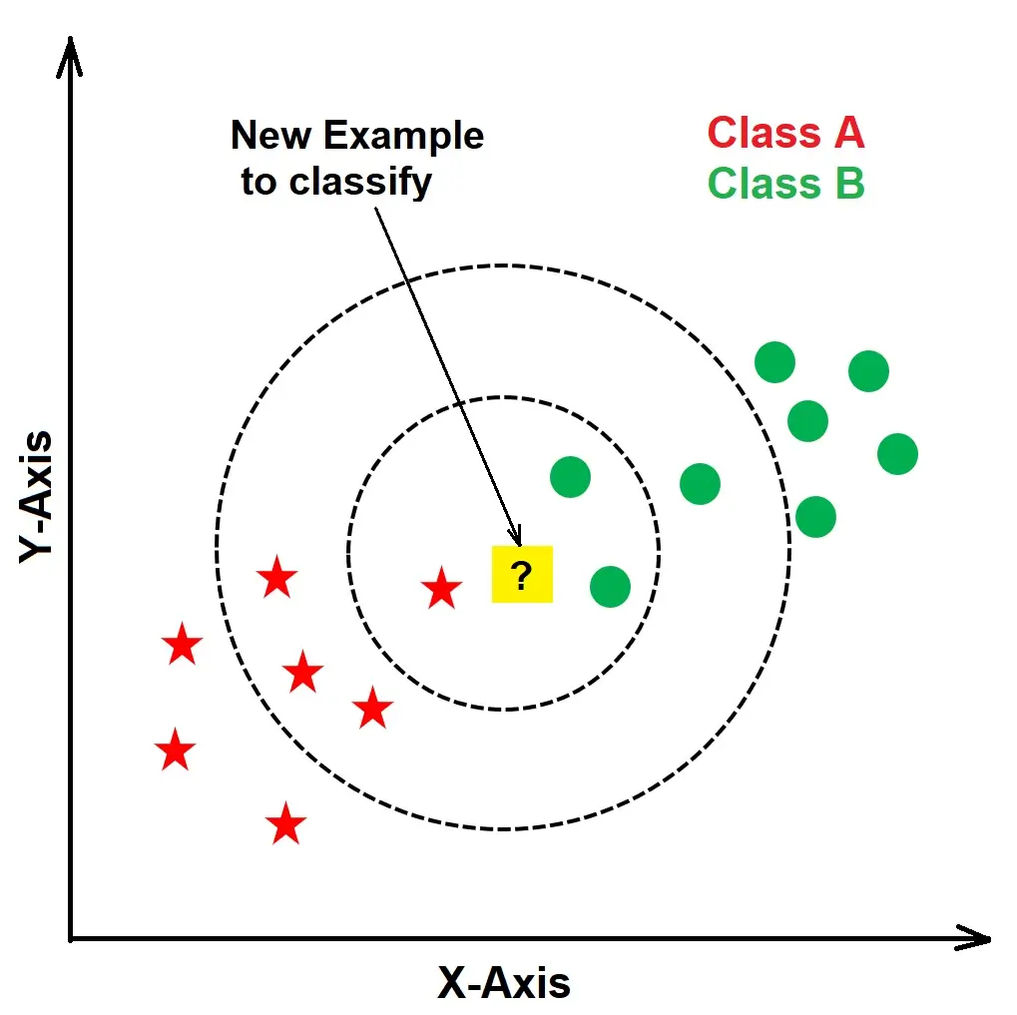
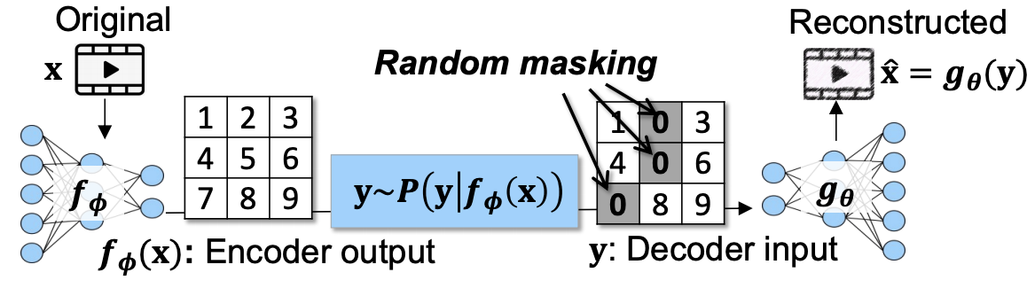
Can Machine Learning Help?
netML
Stats
Sizes
IAT
Samp-Num
Samp-Size
References [9, 10, 11, 12, 13]
Notes:
As the empirical approaches to clustering misconfiguration were inconclusive, we ask, can machine learning help approach this problem from a different perspective?
Machine learning has been applied to a number of different problems in networking, varying both in complexity of the problem itself, and complexity of the approach.
NEXT
For instance, simple supervised models such as k-Nearest-Neighbor, can aid in performing basic classification such as fingerprinting, attack detection, simply by comparing a new sample with its neighbors.
NEXT
More complicated applications of machine learning such as GRACE, use neural networks to provide more loss resilient video playback to users.
NEXT
In our problem of clustering misconfiguration there exist many approaches (both non-ML and ML) that detect individual cases of misconfiguration. For instance, a open source tool called the testssl.sh project runs a straightforward “checklist” of items to determine if a site has improper configuration.
NEXT
Similarly, pipelines that use either raw PCAP data, as input such as nPrintML, or higher level, flow based features, such as netML similarly can be trained to classify TLS configurations. However, these methods don’t allow us to try to reason about why various misconfigurations manifest, or how these misconfigurations may be related to each other.
NEXT
Transformer models differ from previous methods in that during training, they do not rely on explicit features or labels. Instead, these models learn the semantic meaning of each segment of an input and use this semantic understanding to generate predictions. Implicitly, this means that they learn to understand the relationships in and between the given inputs, exactly what we are trying to better understand for misconfiguration.

Slide 8
Can Transformer-based models help us better understand how TLS misconfigurations manifest?
Notes:
Hence, in this work, we aim to answer the following question – can Transformer models help us better understand how TLS misconfigurations manifest?

Slide 9
Specifically…
What representation(s) of networking traffic are effective for use with Transformer models?
Can Transformer models capture/provide a different view on interactions found in TLS configurations?
Proof of Concept
Notes:
Specifically, there are two sub-questions from the original question that I hoped to answer in this work:
NEXT
What representations(s) of networking traffic are effective for use with Transformer models?
The format of networking data is unlike text, or images, as I will discuss in the next slide. What is the best way to approach this?
NEXT
Can Transformer models capture or provide a different view on interactions found in TLS configurations?
Many prior works and existing tools can identify one-off, individual cases of misconfiguration, but few works successfully examine how misconfigurations compare with each other at a larger scale, across multiple domains or points of data.
Further, we want to see if the output of a Transformer model can provide a useful, different perspective on comparing these misconfigurations, that may be more effective than existing heuristic/rule based approaches
NEXT
I note here that this work is a proof of concept for seeing if Transformers can help us understand how misconfiguration manifests, and focuses only on the technical reasons for misconfiguration mentioned a few slides ago. However, the results are promising and I feel it can be extended to the “human reasons” in the future!

Slide 10
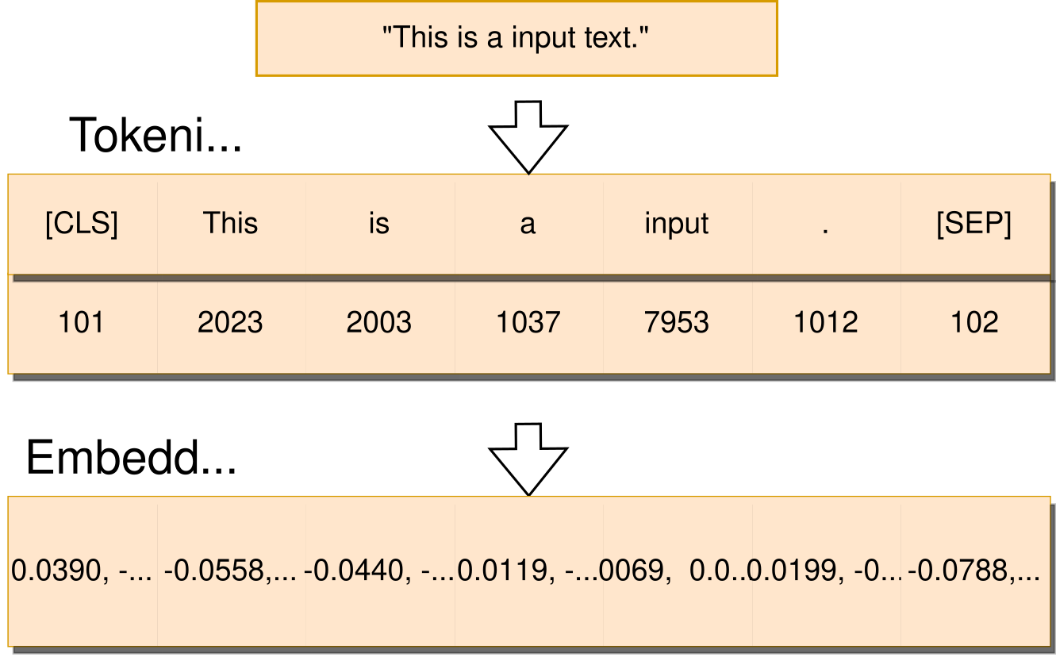
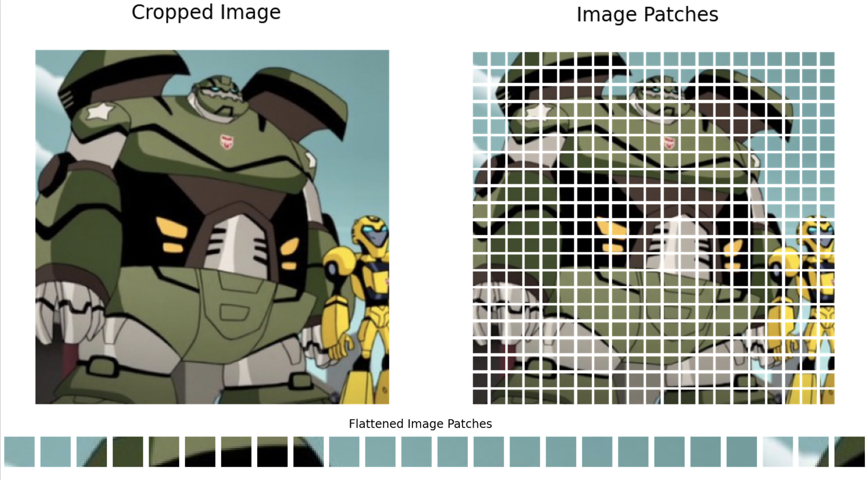

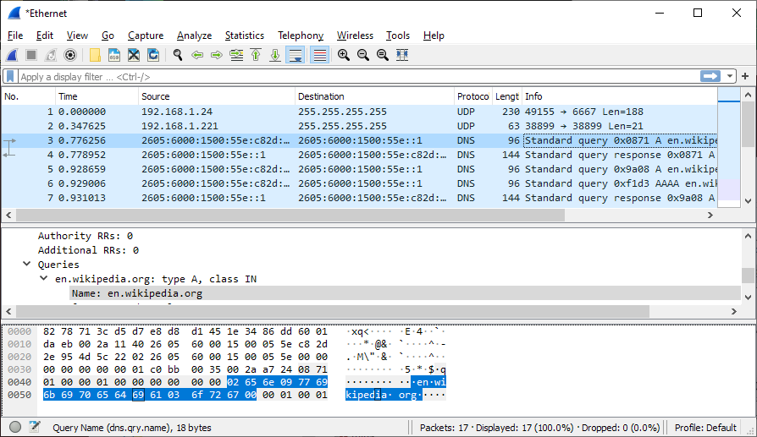
Transformer-based Models and Network Data
References [14, 15]
Notes:
To start answering the first sub-question, it is important to first understand the major challenge behind applying Transformer-based models to networking traffic, which relates to the nature of networking data itself.
NEXT
Raw networking data is not naturally segmentable into words, sentences, or paragraphs as done the natural language domain.
NEXT
It also cannot be treated purely as raw data as done in the audio and computer vision domains, as networking data is inconsistent in form. For instance, one packet header field may represent message extension struct while another may be simply of type integer
NEXT
Thus, we must find a way to present network data to a Transformer-based model that both works with the model architecture, and effective captures the structure and/or relationships in packet data.

Slide 11
Transformer-based Models and Network Data
Sequences of values of a single header field for some protocol^{[20]}
Sequences of high level flow based features for a session^{[21]}
Bigram strings created from byte pairs in flows^{[22]}
Naive adaptive approach: mapped string representations of header data
Network Data Representations – Prior Work
Notes:
The prior works that try applying Transformer models to networking data have used a number of input formats, namely:
NEXT
Sequences of values of a single header field for some protocol (this may not capture the context of the packet, or the session)
NEXT
sequences of high level flow based features for a session (similarly, this may not capture the context of the packet)
NEXT
Use bigram strings created by converting pairs of bytes in flows from sampled PCAP data (this may be too much data, models are limited to 2000 tokens so they must truncate this input and thus lose context in the process. This also looks only at the packet level)
NEXT
All these methods have been successful in their specific application, but as noted, have shortcomings.
NEXT
We try a naive approach that adapts network traffic to strings, the format expected BERT model, and keep only the mapped strings that are relevant to TLS configuration, removing noisy signals. It’s important to note here that similar to previous work, this approach is tailored to our TLS handshake problem; we only care about a small sequence of packets at the beginning of a session, and these values can be easily mapped to human-readable strings. I’ll discuss the specifics of this approach in later slides.

Slide 12
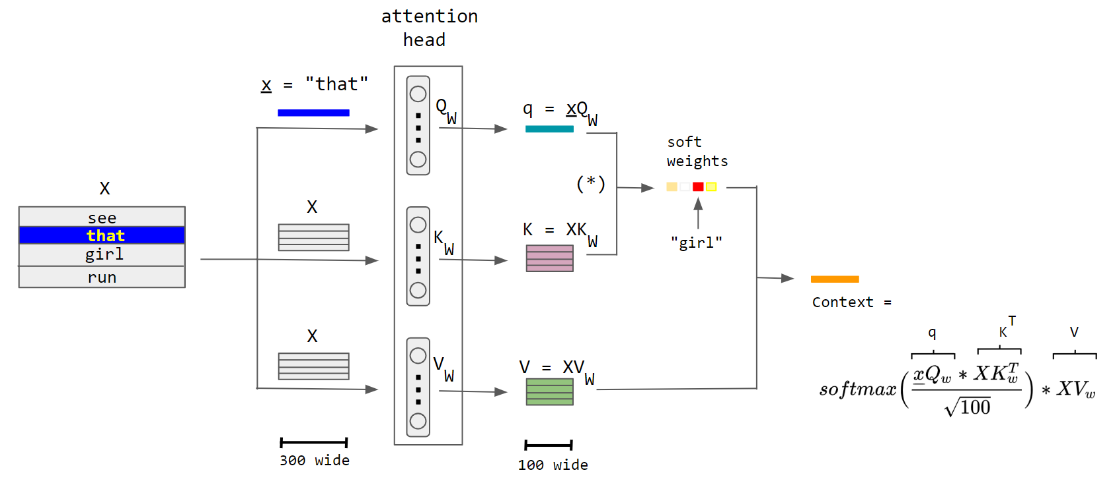

Background – Attention
q := feature vector for element being paid “attention” to
K := feature vector for what the element is “offering”
V := feature vector to average over
Q_{W}, K_{W}, V_{W} := model parameter matrices representing input structure
Context:
Vector representing how strongly "attends to"
(is correlated with) other elements in X
References [16]
Notes:
To begin approaching the second sub-question, “Can Transformer models capture or provide a different view on interactions found in TLS configurations?”
it is important to first understand how these transformer models work. To begin, I’ll briefly explain the attention, a mechanism originally created for neural machine translation.
The figure shown is an example of how attention works. To begin, let us consider an example input X, made up of the sentence “see that girl run,” and consider that we are focusing on the word “that”, represented by x_underbar.
NEXT
First, three parameter weight matrices which capture the structure of the input and for the model, Q_W, K_W, and V_W are created from X.
NEXT
Three feature vectors query, Keys, and Values are created by taking the dot product of X and the respective weight matrix, where q := feature vector for element being paid “attention” to by the attention head, K := feature vector for what the element is “offering” (i.e., its position/meaning in the sentence), and V := feature vector for the whole sentence to average over.
NEXT
Next, the query vector is compared (via dot product) with each word in the keys, before the result of this operation is then thrown into the softmax function (denoted by the asterisk in parenthesis). In the math scope, this calculates a probability distribution over the input weights. Practically, this helps the model discover the most relevant word for the query word. In this case "girl" was determined to be the most relevant word for "that".
NEXT
Finally, multiplying this against the value matrix amplifies the signal for the most important words in the sentence in relation to our chosen query word “that,” and diminishes the signal for less important words. This final vector is the context vector for “that,” which can
NEXT
mathematically be represented as follows.
In practice, the context vectors of all words can be calculated using the whole matrix X, instead of the single word's embedding vector x_underbar, to parallelize the calculations
https://lilianweng.github.io/posts/2018-06-24-attention/
https://uvadlc-notebooks.readthedocs.io/en/latest/tutorial_notebooks/tutorial6/Transformers_and_MHAttention.html
https://en.wikipedia.org/wiki/Attention_(machine_learning)

Slide 13
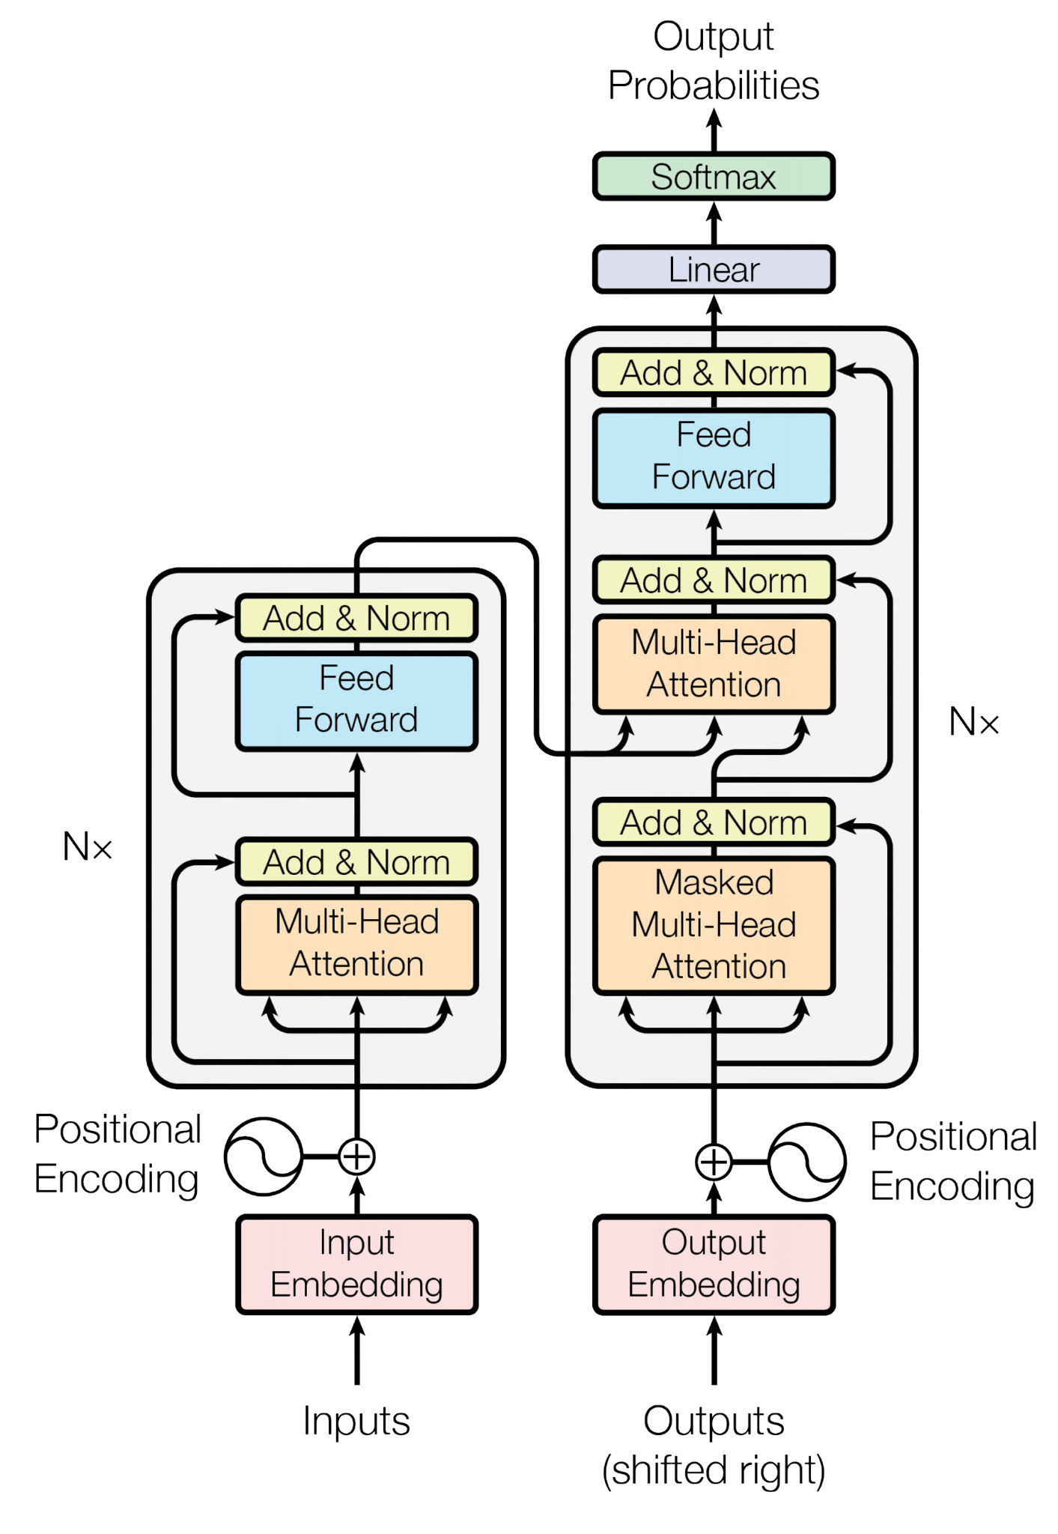
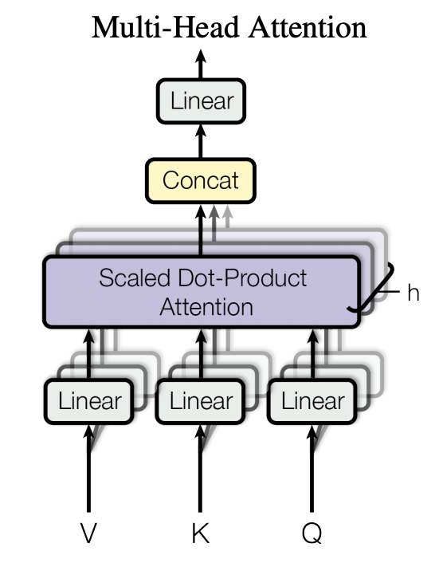
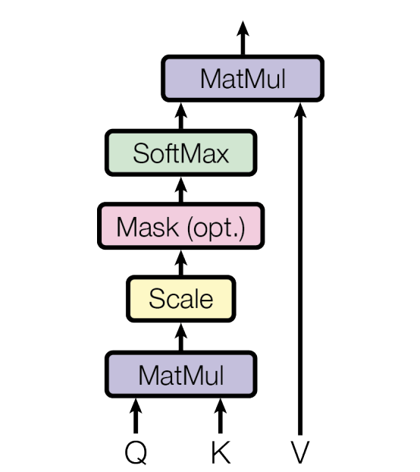
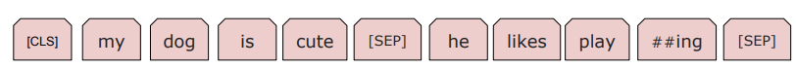
Background – Transformer Model Architecture
Decoder
Encoder
Multi-Head Attention
Input
Scaled Dot-Product Attention
Can Transformer models capture/provide a different view on interactions found in TLS configurations?
(1) “my dog is cute”, (2) “he likes playing”
References [17]
Notes:
Now that we’ve covered attention, we can quickly look at the architecture of the original Transformer model.
NEXT
The model has two parts, an encoder and decoder. At a high level, an encoder learns the context of input tokens, and a decoder generates output based on a given start token (i.e., prompt)
NEXT
To begin, inputs are tokenized in the encoder to create the input embedding.
NEXT
The model then performs multi-head attention in two places: the encoder, where it learns the semantics of the tokenized input, and the decoder, where it uses both the meaning of tokens from the encoder and its previously generated output, to influence subsequent output generation. Each head in multi-head attention (the shadows) learns a different set of weight matrices, allowing the Transformer to encode multiple relationships and nuances for each token.
NEXT
Here, the attention process functions as we discussed in the previous slide.
The results of attention from the multiple heads are then passed to the feed forward layer, which processes the concatenated output from all of these heads. This process is repeated over all data in the training set for the desired number of steps/epochs, with the output of the decoder (right) being used to inform any downstream tasks.
NEXT
Thus, thinking back to our second sub-question, there is not reason why Transformer models should not be able to be applied to networking data. The model will take in any input of networking data we give it. What remains is a question of if the chosen input format for networking data is effective at capturing the necessary relationships found in networking traffic.

Slide 14
Approach
Train BERT model from scratch on parsed TLS handshakes
Server Hello:
tlsv1_2
tlsv1_2 tls_rsa_with_aes_256_cbc_sha256 secure_renegotiation sha256_rsa sectigo_rsa_domain_validation_secure_server_ca gb salford greater_manchester sectigo_limited mysignia_ca rsa digital_signature key_encipherment server_auth client_auth sha256_rsa sha384_rsa usertrust_rsa_certification_authority us jersey_city new_jersey the_usertrust_network sectigo_rsa_domain_validation_secure_server_ca gb salford greater_manchester sectigo_limited rsa digital_signature ....
tls_rsa_with_aes_256_cbc_sha256 secure_renegotiation …
[MASK] secure_renegotiation …
2. Fine-tune model on correctly configured/misconfigured TLS data
Can the model differentiate between the two? (Binary classification)
Can the model differentiate between reasons for misconfiguration? (Multi-label classification)
Notes:
To validate this, I took the following, relatively straightforward approach.
NEXT
I first trained from scratch a BERT model, an encoder-only model that uses the Transformer architecture, using parsed TLS handshakes. On screen is an example of this parsed input representation, which I’ll discuss in more detail in a few slides.
NEXT
I then and evaluated the model’s “understanding” of the input using the standard Masked-Language model task, in which the model is given a example input with some token missing, and is asked to “fill in the blank.” If the model performs well in this task, it is an indicator that it understands the input structure, and can be used for fine-tuning on more complex downstream tasks.
NEXT
I then fine-tuned the model on labeled, correctly configured and misconfigured TLS handshakes, with the goal of seeing if my model could differentiate between the two.
NEXT
Specifically, I fine-tuned the model to differentiate between proper/improper configuration, binary classification,
NEXT
and also fine-tuned to see if the model could discern between different reasons for misconfiguration, multi-label classification

Slide 15
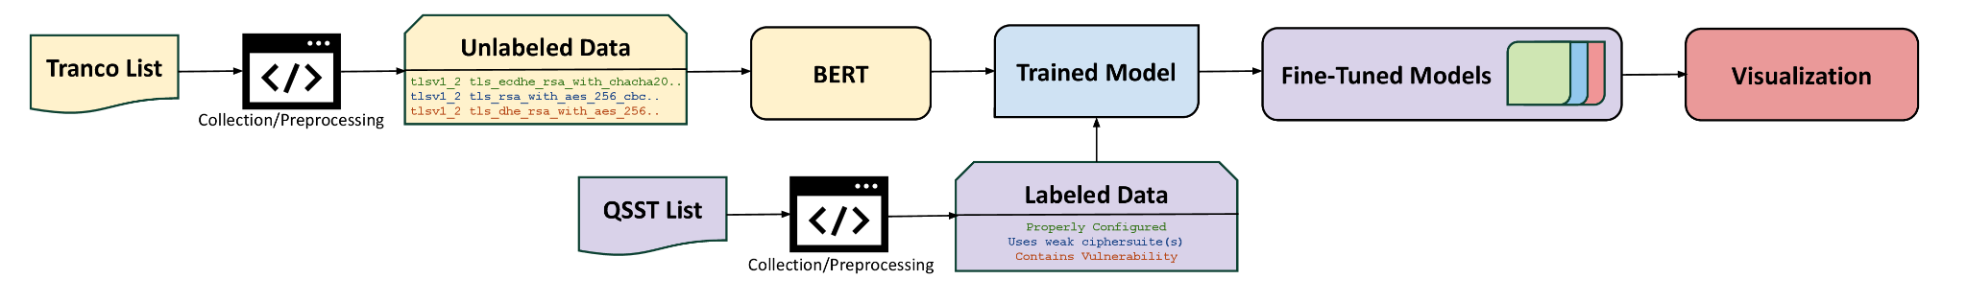
Model Pipeline
Notes:
Shown is an overview of the pipeline for the trained BERT model. First, we collect TLS handshakes from sites on the Tranco List to use as unlabeled training data for pre-training our model. We then collect handshakes from Qualys SSL Server Test List to use as labeled training data to fine-tune our model, and visualize the resulting embeddings. I’ll go into more detail of each step in the following slides.

Slide 16
Data Collection, Preprocessing and Tokenization
Tranco top million list
{
"ip": "<IP_ADDR>",
"domain": "<DOMAIN>",
"data": {
"tls": {
"status": "success",
"protocol": "tls",
"result": {
"handshake_log": {
"server_hello": {
"version": {
"name": "TLSv1.2",
"value": 771
},
"cipher_suite": {
"hex": "0x003D",
"name": "TLS_RSA_WITH_
AES_256_CBC_SHA256",
"value": 22
},
"compression_method": 0,
"ocsp_stapling": false,
"ticket": false,
"secure_renegotiation": true,
"heartbeat": false,
"extended_master_secret": false
},
....
....
{
"ip": "<IP_ADDR>",
"domain": "<DOMAIN>",
"data": {
"tls": {
"status": "success",
"protocol": "tls",
"result": {
"handshake_log": {
"server_hello": {
"version": {
"name": "TLSv1.2",
"value": 771
},
"cipher_suite": {
"hex": "0x003D",
"name": "TLS_RSA_WITH_
AES_256_CBC_SHA256",
"value": 22
},
"compression_method": 0,
"ocsp_stapling": false,
"ticket": false,
"secure_renegotiation": true,
"heartbeat": false,
"extended_master_secret": false
},
....
....
tlsv1_2 tls_rsa_with_aes_256_cbc_sha256 secure_renegotiation sha256_rsa sectigo_rsa_domain_validation_secure_server_ca gb salford greater_manchester sectigo_limited mysignia_ca rsa digital_signature key_encipherment server_auth client_auth sha256_rsa sha384_rsa usertrust_rsa_certification_authority us jersey_city new_jersey the_usertrust_network sectigo_rsa_domain_validation_secure_server_ca gb salford greater_manchester sectigo_limited rsa digital_signature
tlsv1_2 tls_rsa_with_aes_256_cbc_sha256 secure_renegotiation sha256_rsa sectigo_rsa_domain_validation_secure_server_ca gb salford greater_manchester sectigo_limited mysignia_ca rsa digital_signature key_encipherment server_auth client_auth sha256_rsa sha384_rsa usertrust_rsa_certification_authority us jersey_city new_jersey the_usertrust_network sectigo_rsa_domain_validation_secure_server_ca gb salford greater_manchester sectigo_limited rsa digital_signature
WordPiece tokenization: 32,000 tokens
assurance
1d4
goget
gogetssl
##ions
##yp
##net
##ong
##ting
secure
AES
renegotiation
ECDSA
128
GCM
server_hello
certificate
chain
Notes:
To begin, I used the Tranco top list, a popularity list of the top 1 million websites in the world, to easily have a set of likely reachable sites to make TLS handshakes to for collecting data.
I collected the handshakes themselves by using a scanner written for the related work paper I showed in the previous slides, which is written in Go and uses the ZMap scanner, a state of the art high speed network scanner.
For each site, I established handshakes using ~100 different ciphersuite options. The scanner returns the JSON format on the left, of the server replies in a TLS handshake. I then parse this output into the format on the right, which removes all noisy data fields (e.g., cryptographic values, data payloads)
NEXT
This visualization shows the mapping between my parsed data representation and steps in the server messages of a TLS handshake, for example, server_hello, certificate, and chain. The latter two are visible in the JSON on the left due to space, but the mapping idea is consistent
NEXT
After collecting and parsing all handshakes, I tokenized this input using WordPiece, the standard tokenizer for the BERT model, resulting in 32,000 tokens. Some example tokens are shown

Slide 17
Model Training – Pre-training Evaluation
5GB of parsed handshakes → 8,681,927 inputs → 394,839,183 words
(about 1/10 of volume of original BERT training corpus)
Trained over 4 epochs on University AI Cluster
masked_lm_accuracy = 0.98815787
masked_lm_loss = 0.07483223
Notes:
The final data used to train my model was around 5GB of parsed handshakes, which amounted the input sizes on the slide. I trained this model over 4 epochs on the University AI cluster, and reached 98.8% masked language model accuracy, (a task in which words are masked off and the model attempts to “fill-in-the-blank”), and similarly had low loss, an indicator that my model understood the TLS handshake input.

Slide 18
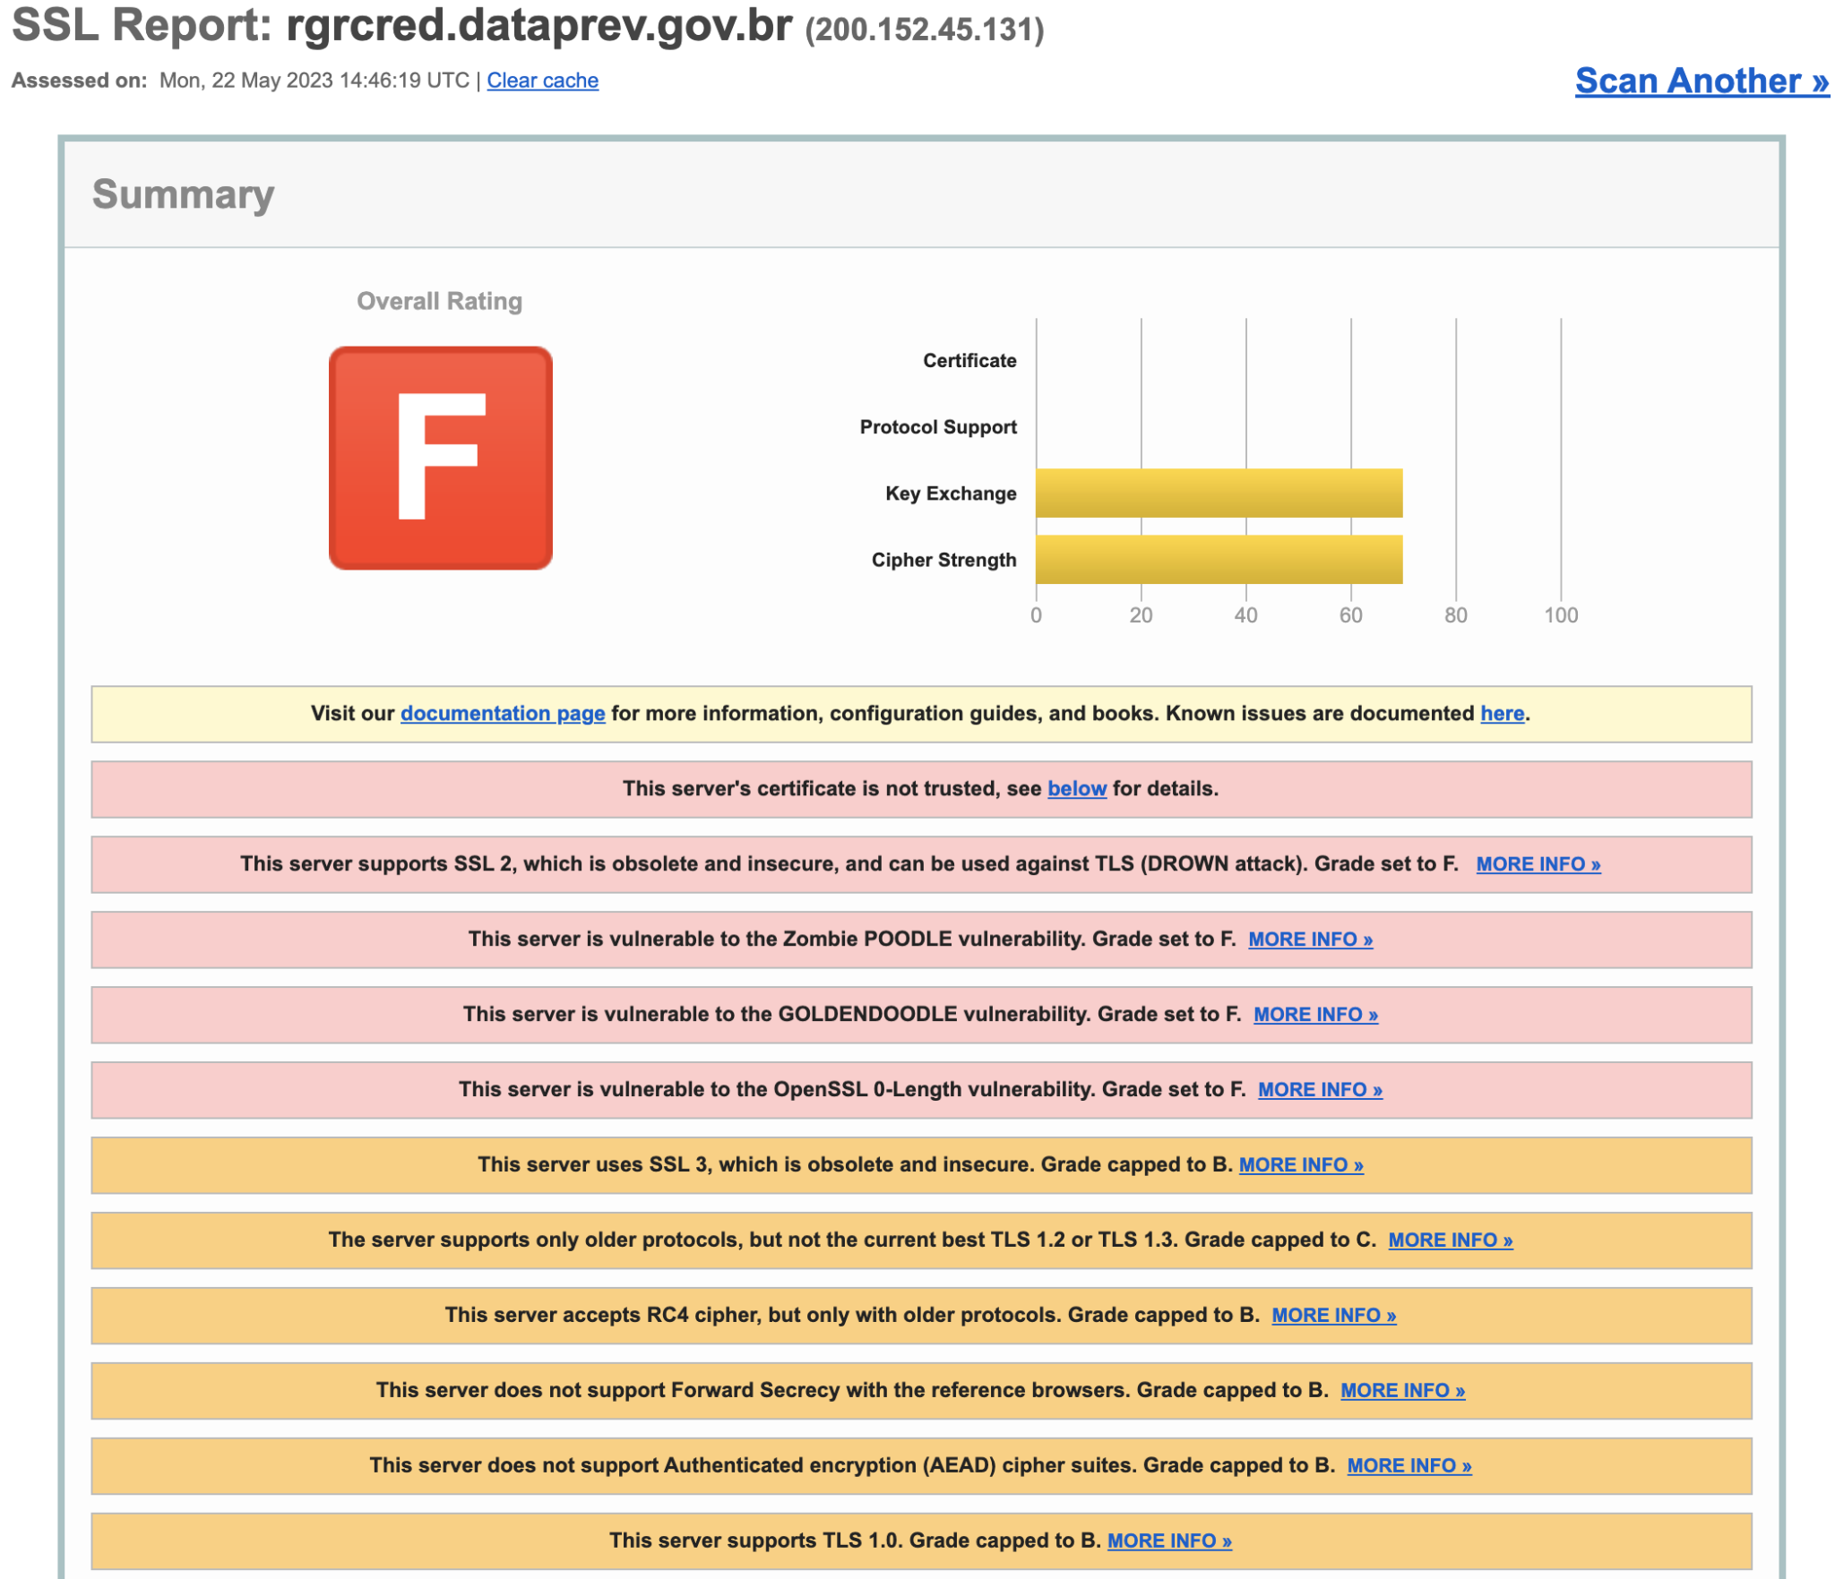
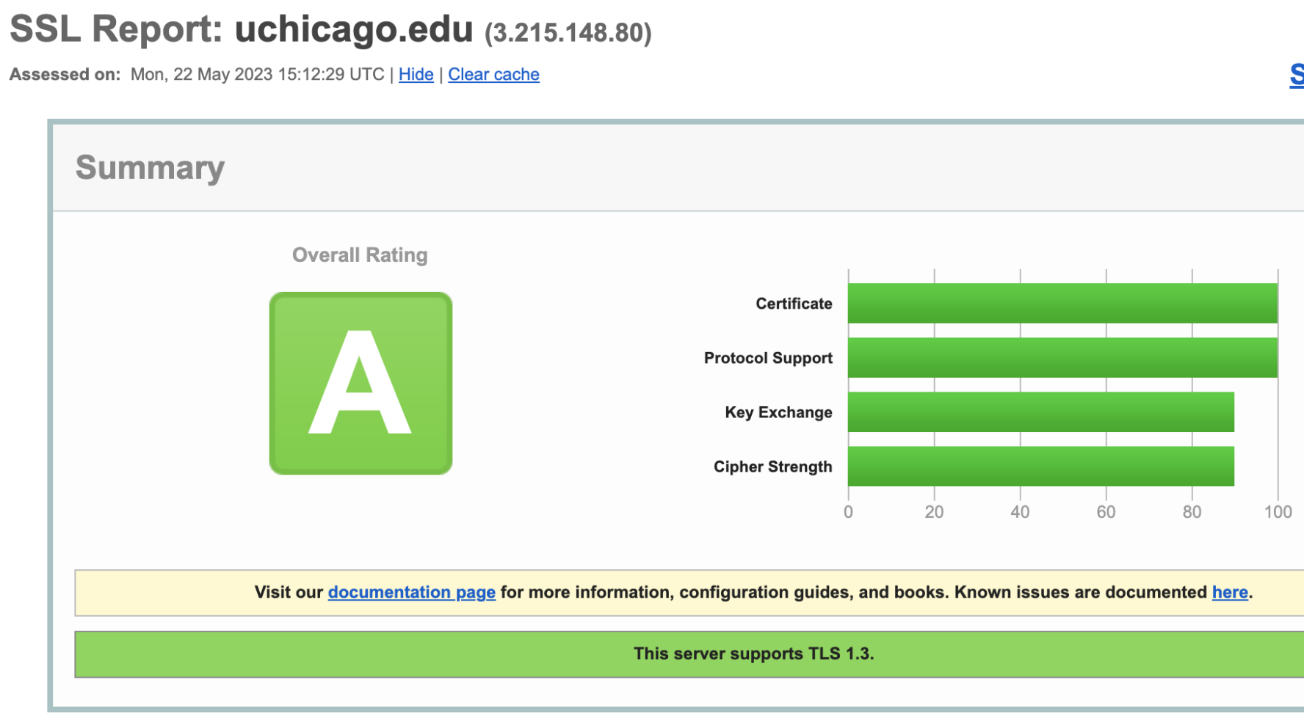
Model Fine-tuning
Misconfigured Sites: 2,240
Properly Configured Sites: 42,877
References [18]
Notes:
I then fine tuned the model on parsed TLS handshake data labeled as both as correctly configured and misconfigured. I wrote a crawler to collect the classification of websites via an online report called Qualys SSL Test as a ground truth for labeling, which assigns sites a letter rating of “A+” through “F”. This report is reliable for a ground truth as it runs comprehensive tests of different technical reasons for misconfiguration (e.g., different ciphersuites, clients making the handshake). For all “A” or A+” rated sites, I these sites as “properly configured,” and for all “F” rated sites, I labeled these sites as “misconfigured.”
For “misconfigured” sites, I then also used the testssl.sh tool, a script that allows for easier automated collection for TLS data about sites. This provided five distinct sub-labels for misconfiguration: certificate issues, contains vulnerability, issues with the chain of trust, protocol version issues, and uses weak ciphersuites.

Slide 19
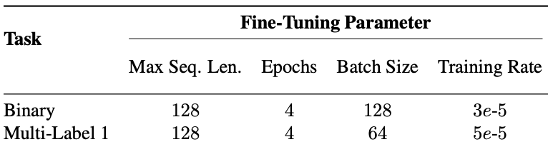
Model Fine-tuning – Data Collection
Misconfigured Sites: ~1,300
— 18,629 handshake inputs
Properly Configured Sites: ~42,000
— 332,651 handshake inputs
Dataset: 37,258 inputs
Notes:
I then used the same Zgrab scanner tool to make handshake requests to these collected sites, and collected all handshakes. To create a balanced dataset of inputs from either group, I use all inputs collected from the misconfigured sites, and select a matching 18,629 inputs at random from the larger pool of inputs of properly configured sites. This yields the final fine-tuning task dataset of 37,258 inputs.
I then performed grid-search of hyperparameters for both fine-tuning tasks of binary, and multi-label classification. The table shown presents the best hyperparameters for use with the pre-trained BERT model.

Slide 20
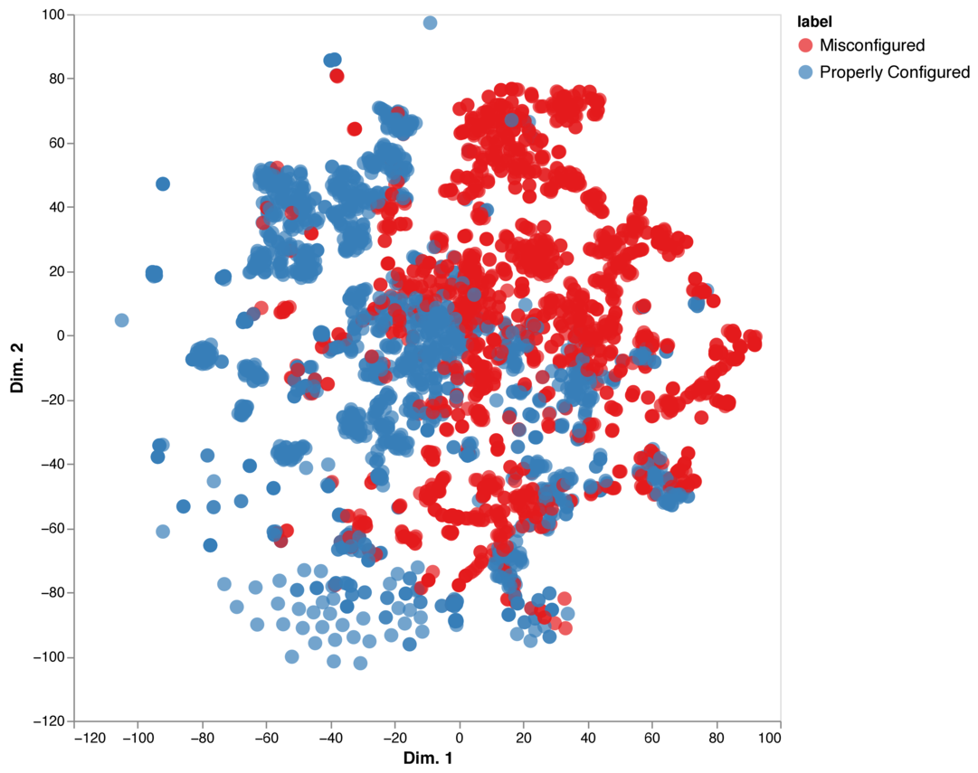
Model Fine-tuning – Binary Classification
Accuracy = 97.6%
F1 = 97.6%
Loss = 0.099 nats
Notes:
In the binary classification task, the fine-tuned model was able to successfully discern properly and misconfigured settings with high accuracy and F1, as well as low loss.
NEXT
We then visualized the input using the t-distributed Stochastic Neighbor Embedding (t-SNE), casting the 768-dimension embeddings of our model to two dimensions.
NEXT
We can see distinct clusters of both misconfigured and properly configured sites,
NEXT
as well as a relatively clear boundary between the two classifications.

Slide 21
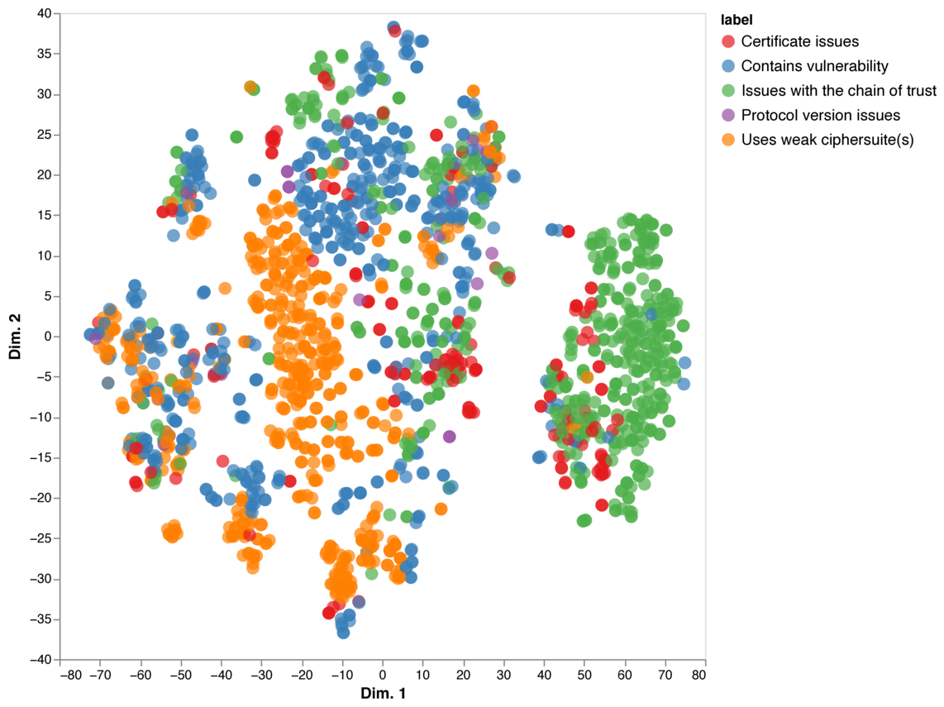
Model Fine-tuning – Multi-label Classification
Accuracy = 96.7%
F1 = 96.6%
Loss = 0.109 nats
MCC = 0.953
Notes:
In the multi-label classification task for misconfigured sites, the fine-tuned model was similarly able to separate properly and misconfigured settings with high accuracy and F1, low loss.
When constructing our datasets for the multilabel classification tasks, I observed that some reasons for misconfiguration were more prevalent than others, indicating class imbalance.
To account for this, I also measured the Matthews Correlation Coefficient (MCC), a performance metric that yields a high score only when a model’s predictions match the true labels at a high rate, independent of the ratios of each class in its dataset [1]. Ranging between [−1, +1], a MCC of ±1 indicates perfect prediction or total disagreement, while a MCC of 0 indicates prediction is no better than random. Our models also perform well in this metric, having a MCC of least 0.95 for all tasks.
NEXT
Visualizing the input again using t-SNE, we can see distinct clusters of various more specific reasons for misconfiguration.

Slide 22
Takeaways
Transformer-based models can detect TLS misconfiguration
A parsed, string-based, space-delimited representation of traffic data can be effective for use in training Transformer-based models
Using this representation, Transformer-based models can find semantic similarities in TLS misconfigurations, causing distinct reasons for misconfiguration to visually cluster together
Visualizing fine-tuned model classification embeddings provides a different perspective for comparing TLS implementations
Notes:
Here are the major takeaways for this work.
NEXT
If we recall the original research question: “Can Transformer-based models help us better understand how TLS misconfigurations manifest?”, the first question here is whether transformer models can detect misconfiguration to begin with. It seems that the answer here is yes; we achieved high model performance on our tasks of detecting and grouping TLS implementations, based on technical reason for misconfiguration.
NEXT
For the first subquestion of “What representation(s) of networking traffic are effective for use with Transformer models?”, we show that a naive mapping of TLS messages to strings is consumable by the model,
NEXT
and allows a transformer model to reason about the interactions that cause misconfiguration in TLS
NEXT
For the second, “Can Transformer models capture/provide a different view on interactions found in TLS configurations?” we show how the model captures the relationships between configuration settings in TLS by visualizing the final layer classification embedding for differently configured sites.

Slide 23
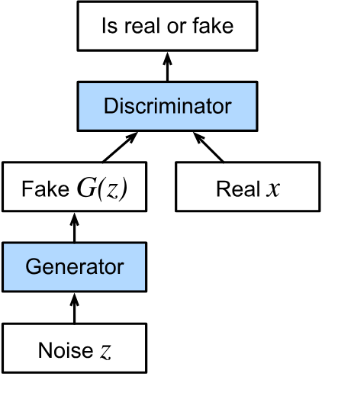
Generative Adversarial Networks (GANs)
The generator creates data that mimics real data (e.g., images, audio, text).
The discriminator evaluates the authenticity of the data (real vs. generated).
Both networks are trained simultaneously in an adversarial process.
Common applications include realistic image generation, style transfer, and synthetic data creation.

Slide 24
Diffusion Models
Diffusion models are probabilistic generative models.
Model the transformation of data into noise through a forward diffusion process.
Reverse process learns to generate data samples from noise.
Known for producing high-quality images and realistic generative outputs.
Increasingly important in modern AI research for image synthesis and generative tasks.

Slide 25
Network Trace Datasets
Why do we need them?
Training ML models for:
Anomaly Detection,
Activity Recognition,
....
What are these datasets?
Network Trace Dataset
NetFlow/IPFIX-style aggregated statistics
Raw traffic traces (pcaps)
Hardware/Software testing
And more…
Notes:
So network trace datasets generally fall into two categories, either flow-level statistics, which include data like duration and byte counts, or raw traffic traces in formats like pcaps or tcpdumps.
And these datasets are useful in many downstream tasks like training machine learning models for traffic analysis and conducting hardware or software testing.

Slide 26



Scarcity of Datasets
Potential Solution: Synthetic network data generation
Privacy/confidentiality
Maintenance Costs
Collection Errors
Notes:
However, the availability of these datasets are limited because of concerns in publicly sharing them, including privacy leaks, maintenance costs, and potential collection problems.
1. To address this scarcity, one solution is to derive synthetic data from existing datasets.

Slide 27
Simulations/heuristics approaches:
Pro: Can produce full headers/payloads (pcaps)
Cons:
Require extensive manual effort and domain knowledge
Non-generative, i.e., low levels of variations
ns-3
YANS
MGEN
Notes:
Early methods for generating synthetic network data, like ns-3, YANS, and MGEN, can produce traffic with full headers and payload, but need a lot of manual effort and domain knowledge to configure.
And they mainly retransmit existing traffic, meaning that they only change meta-attributes like timestamps or traffic rate but leave the traffic content relatively untouched.
So, while useful, they limited for improving ML models which often want some variation in generated traces to enhance model's robustness against unseen events.

Slide 28
GAN-based Generations
Pros:
Generative: Introduce variations
Attempts to achieve high statistical resemblance to real data
DoppelGANger
NetShare
Notes:
More state of the art solutions for producing synthetic network data start to use automated ML techniques such as generative neural networks.
With representative tools such as DoppelGANger and NetShare.
These models produce non-identical yet realistic variations of real traces, which can help simulating unseen events in the original dataset. At the same time, they aim to maintain high overall statistical similarity to real data to maximize the synthetic data's practical use in real-world scenarios.

Slide 29
GAN-based Generations
Pros:
Generative: Introduce variations
Attempts to achieve high statistical resemblance to real data
Cons:
Unsatisfactory ML accuracy
DoppelGANger
NetShare
Notes:
While these GAN-based tools are great, they have notable limitations due to the current design choices.
First, ML models often experience low accuracy when using these synthetic.

Slide 30
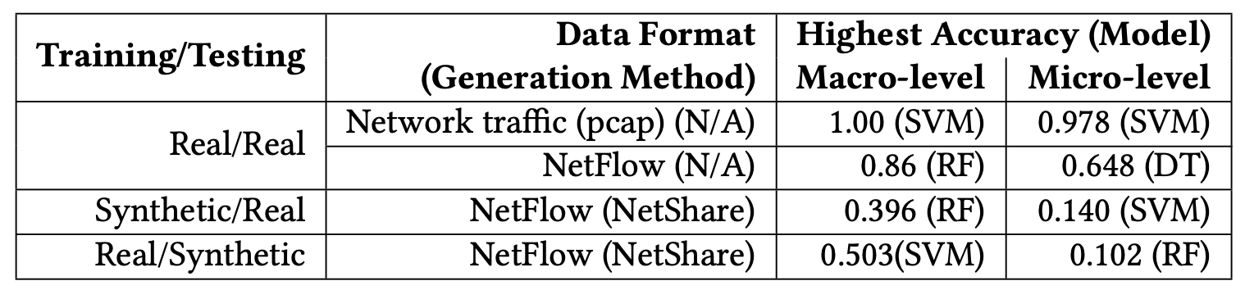
GAN-based Generations
Unsatisfactory ML accuracy
Goal: Generation of raw network traffic.
Notes:
For instance, using NetShare as an example which produces netflow like attributes,
We first see that training and testing a model for service classification on completely real NetFlow data is much more accurate than when synthetic data is used. This can potentially be because these synthetic data fails to adequately preserve critical distinguishing feature values in the real dataset, which negatively affects the models’ in classification accuracy.
And secondly, most current methods generate only aggregated flow-level statistics, and even when they attempt to produce packet-level details, they include only a few packet headers.
But we see that learning from raw network traffic such as pcaps tend to produce higher accuracy than learning from netflow like attributes since there are much more useful information to learn from.
These observations prompt us to explore whether it is feasible to generation raw network traffic to retain the fine-grained details and statistical properties of real network traffic to overcome this ML accuracy gap.

Slide 31
GAN-based Generations
Pros:
Generative: Introduce variations
Attempts to achieve high statistical resemblance to real data
Cons:
Unsatisfactory ML accuracy
Limited Applicability to Non-ML tasks.
Does not support retransmission and in-depth analysis
Does not emphasize on conformance to network rules
DoppelGANger
NetShare
Notes:
At the same time, these methods generally have Limited Applicability to Non-ML tasks due to the fact that they only produce summary attributes which makes critical functionality such as retransmission and in-depth analysis like wireshark impossible.
And they generally do not enforce network-specific rules during generation, meaning while the statistical resemblance can be high, the produced traffic doesn’t necessarily conform to protocol standards.

Slide 32
GAN-based Generations
Shortcomings:
Unsatisfactory ML accuracy
Limited Applicability to Non-ML tasks.
Can we address these concerns?
Ideal tool: An interactive generator where we can ask the generator the type of raw network traffic we want.
Notes:
Now the question is, can we design a generation pipeline to avoid these issues?
1. And specifically, in an ideal world, it would be great if we can create a dedicated, interactive generator like ChatGPT where we can ask it the type of traffic we want and it can produce it according to our request.

Slide 33
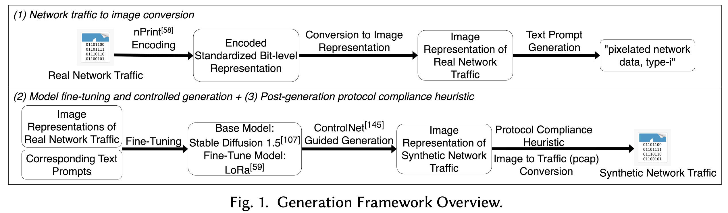
A Text-to-traffic Synthesis Paradigm
A generative text-to-image diffusion model on image-representations of raw network traces (pcaps).
Notes:
Inspired by the success of recent text-to-image models, we propose a framework that harnesses controlled text-to-image diffusion models to generate synthetic raw network traffic that complies with transport and network layer protocol rules.
This framework is consisted of three components which starts off with converting real network traffic used for training the generation model into image representations.
The second component involves fine-tuning the generation model using the image dataset and carry out controlled generation to largely make sure that the generated protocol and header field distributions are correct.
And the last step would be carry out detailed post-generation heuristic to further ensure protocol compliance by examine each generated header field bits in detail and correct them if needed.

Slide 34
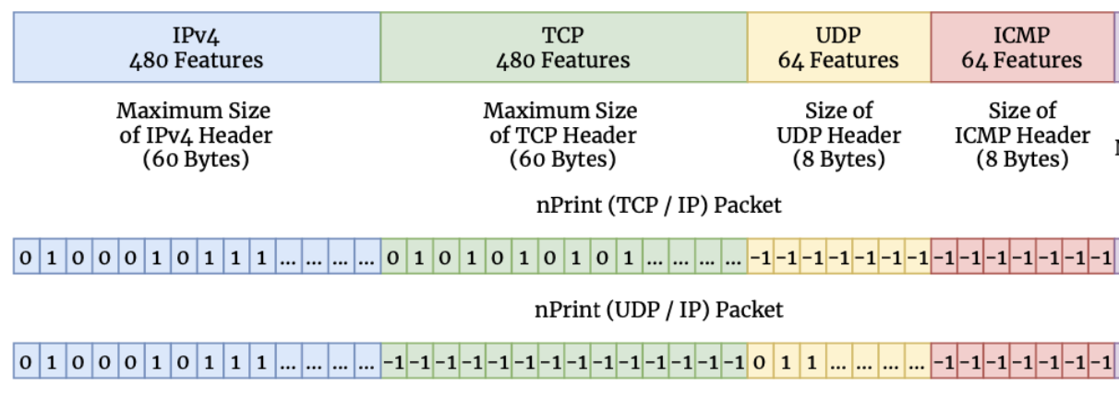
A Text-to-traffic Synthesis Paradigm
Generation Overview:
Step 1 – Training dataset curation (using nPrint-encoded pcaps)
Dataset Curation
Encoded pcap-to-image conversion
Label-based prompt generation, e.g., ‘type-0, Netflix traffic’
Notes:
In the generation stage of this framework, the first step is to create a dataset for model fine-tuning using real pcaps.
These pcaps are converted into a standardized numerical format using tools like nprint, which transforms header field bits into 1s, 0s, and -1s to represent set, unset, and absent bits.

Slide 35
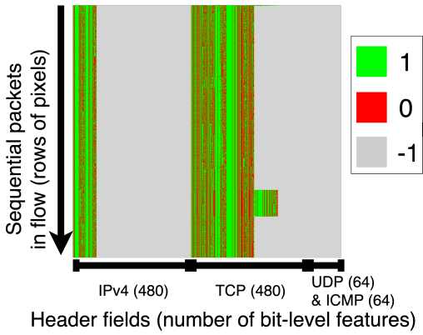
A Text-to-traffic Synthesis Paradigm
Generation Overview:
Step 1 – Training dataset curation (using nPrint-encoded pcaps)
Dataset Curation
Why image representation?
Powerful text-to-image diffusion models with high resolution → Improved feature granularity
Prompt-invoked generation → Class Imbalance Avoidance and style learning
Captures inter-packet relations → utilization of controlled generation techniques
Encoded pcap-to-image conversion
Label-based prompt generation, e.g., ‘type-0, Amazon traffic’
Notes:
The encoded pcaps are then turned into images paired with text prompts from data labels for fine-tuning a text-to-image diffusion model.
An example here is a TCP flow image where each row of pixels here represents transport layer header values of a packet in the flow.
1. The natural question to ask here is, why an image representation.
2. First, this allows us to use many of the existing powerful text-to-image diffusion models capable of producing images with high resolutions, which is particular helpful as we aim to improve feature granularity in synthetic data.
3. Second, most text-to-image models use prompt-invoked generation, which offers control over the quantity of class instances produced and allows the model to learn traffic characteristics corresponding to text prompts.
4. And lastly, this representation effectively captures inter-packet relations within a flow. Because, unlike traditional tabular formats where data points might be perceived as independent entities, images inherently emphasize the significance of a packet concerning its neighboring packets, preserving crucial contextual information.
For instance, in this TCP flow image, we can clearly see that all packets are TCP type since only the IP and TCP pixel columns are colored with green or red. And as we show later, this allows us to use controlled generation techniques designed for text-to-image models.

Slide 36
A Text-to-traffic Synthesis Paradigm
Generation Overview:
Step 2 – Fine-tuning a text-to-image diffusion model
Dataset Curation
LoRa-based Stable Diffusion 1.5 Fine-tuning
Why fine-tuning?
Training a diffusion model from scratch is costly
Fine-tuning techniques allow for few-shot learning → high generalizability
Encoded pcap-to-image conversion
Label-based prompt generation
Fine-tuned text-to-image model
Notes:
To fine-tune the text-to-image model, we used a cost-effective method called low-rank adaptation on Stable Diffusion 1.5, a model pre-trained on billions of general images.
1. We choose fine-tuning an existing model because training a diffusion model from the beginning is resource-intensive, requiring a large amount of data. Second, fine-tuning actually enhances the model's adaptability to various generation tasks. It resembles few-shot learning, where only a small amount of network data is needed to tailor the model to specific generation objectives.

Slide 37
A Text-to-traffic Synthesis Paradigm
Generation Overview:
Step 3 – Controlled Generation, e.g., protocol utilization across packets
Dataset Curation
LoRa-based Stable Diffusion 1.5 Fine-tuning
ControlNet (Canny)-aided Generation
Encoded pcap-to-image conversion
Label-based prompt generation
Fine-tuned text-to-image model
Constrained Generation
Input example: ‘type-0, Amazon traffic’
Notes:
During generation, we give the model the prompt that specifies the type of traffic we want and produce the output. However, during generation, we apply constrains using the tool ControlNet.

Slide 38

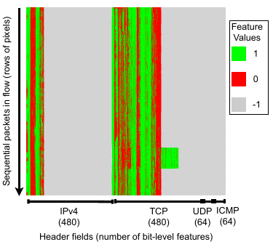
A Text-to-traffic Synthesis Paradigm
Generation Overview:
Step 3 – Controlled Generation, e.g., protocol utilization across packets
ControlNet Input
Constraint Detection
Constrained Generation
ControlNet (Canny)-aided Generation
Constrained Generation
Notes:
ControlNet takes an input of a single example image of the desired network traffic that we want to produce more synthetic versions for.
It carries out edge detection on the example, which in this case marks the region of generation to only TCP and IP header fields.
During generation, it uses these edges as references and ensures that the generated data follows this patterns to only produce TCP packets.

Slide 39
A Text-to-traffic Synthesis Paradigm
Post-Gen Heuristic Overview:
Inter-Packet Rules
E.g., TCP handshake
Intra-Packet Rules
E.g., checksum consistency with payload
“A set of header fields that have low tolerance to randomness.”
Notes:
As a result, we let the controlled generation to fullfill general conformance to the protocol and header field values distributions to the real data, but then further modify and correct the details within the synthetic data to ensure higher levels of compliances to protocol rules. Specifically we divide these into both inter and intra packet rules.
For inter-packet rules, we are looking at the relationships and sequencing between header fields within multiple packets in a network flow. For instance, in a typical TCP connection, packets need to be sequenced properly, starting with the handshake process.
For Intra-Packet Rules we are referring the correctness of the structure and contents within individual packets.
For example, many protocol headers have a checksum field computed based on the packet’s contents to detect errors during transmission. It’s crucial that the checksum is consistent with the packet’s payload.
So to maximize compliance with transport and network layer protocol rules, we first identify a subset of these critical header fields that mandate strict adherence, e.g., sequence and acknowledgement numbers. On the other hand, some fields can accommodate a degree of flexibility without necessarily severally compromising the traffic integrity, such as TCP window size or TTL. The objective here is to limit the scope of fields requiring modification during post-processing, ensuring we retain as much of the original generative model’s output as possible and minimize potential impacts on ML-driven tasks, while still ensuring the synthetic traffic’s compatibility with network analysis tools.

Slide 40
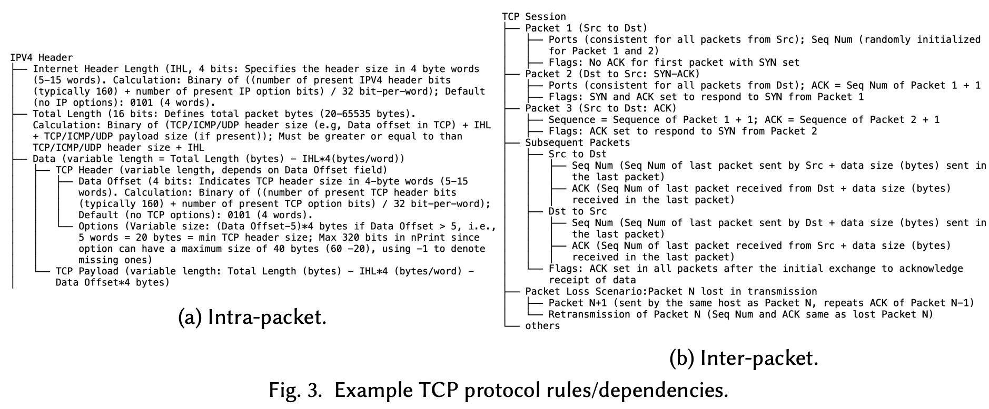
A Text-to-traffic Synthesis Paradigm
Post-Gen Heuristic Overview:
Notes:
We then constructing dependency trees to represent these rules. And for our generated traffic, we traverse the trees bottom-up fashion.
We first make sure that the intra-packet dependencies are satisfied to ensure that individual packets are internally consistent. We then address inter-packet dependencies, guaranteeing that the packets in a flow relate correctly to one another.
For fields that require random initialization or uniformity across packets such as IP addreses and ports, we use majority voting based on the generated values to determine the values.

Slide 41
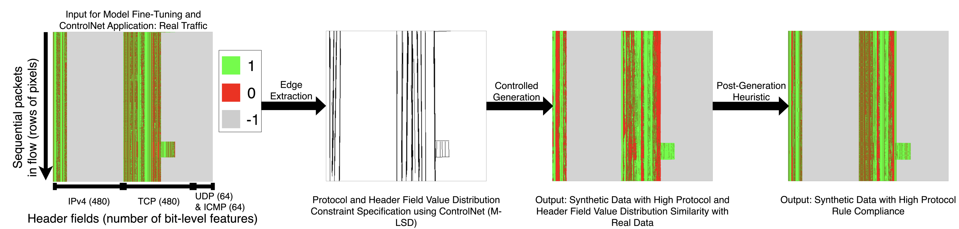
A Text-to-traffic Synthesis Paradigm
Post-Gen Heuristic Overview:
Notes:
And we can see that, after this post-generation heuristic, while still showing variations from the real data, we are seeing much more detailed structure compared to the original output from the controlled generation.

Slide 42
A Text-to-traffic Synthesis Paradigm
Generation Overview:
Step 4 – Synthetic image generation and conversion back to encoded pcaps
Dataset Curation
Encoded pcap-to-image conversion
Label-based prompt generation
Fine-tuned text-to-image model
Constrained Generation
Image representation of encoded pcap
Image-to-encoded pcap conversion
Notes:
The last step of the framework would be taking this produced image representation and
1. convert it back into encoded pcap format which can be used for downstream tasks.

Slide 43
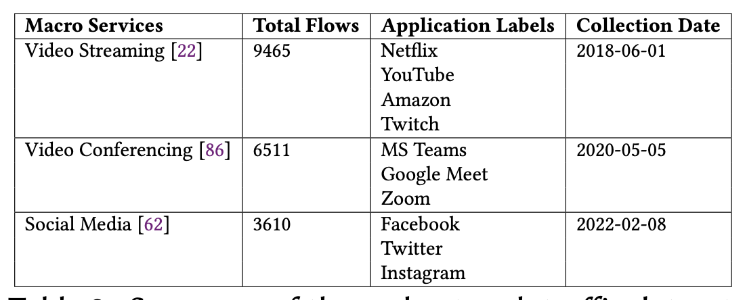
Evaluation
How do these improvements benefit downstream tasks?
We fine-tune the diffusion model using a real dataset (10 applications/3 services)and use it to generate synthetic traffic data.
Training Dataset | Generation Method 1 | Generation Method 2
Real network traces from 11 applications / 3 service types | Our text-to-traffic framework | Time-series based GAN (NetShare)
Notes:
To evaluate how this framework actually benefits the downstream task,
We fine-tune this framework with real network traces from 3 service types such as streaming versus web browsing, which are further broken down in 10 applications such as Netflix and YouTube.
We use the same data to train NetShare, which is a time-series-based GAN generator capable of generating netflow-like attributes and use that as a baseline.

Slide 44
Evaluation
Analysis Evaluation (statistical similarity):
> 30 %
> 70 %
Average Statistical Improvement (common fields)
Average Statistical Improvement (all fields)
Notes:
We first look the statistical similarity of our synthetic data compared to the real data.
We see that, on fields that both our method and the baseline method generates such as the the protocol used, we see an average of greater than 30% improvement in statistical similarity measured using metrics such as jsd and EMD. And on all of the fields generated, our method see over 70% improvement over the baseline.

Slide 45
Evaluation
Analysis Evaluation (traffic classification accuracy):
> 65 %
(a) Train on Synthetic; Test on Real
Notes:
We now look the impact of our synthetic data on machine learning tasks, particularly traffic classification aiming at categorizing flows into particular services or applications.
We first allow the training of the model completely on synthetic data and test the model accuracy completely on real data. And on average we see an higher than 60% improvement in accuracy when our synthetic data is used compared to the baseline synthetic data. This enhanced performance is attributed to our higher granularity, which inherently provide more features for learning, as well as our controlled generation process that attempts to mimic real protocol and header field value distributions.

Slide 46
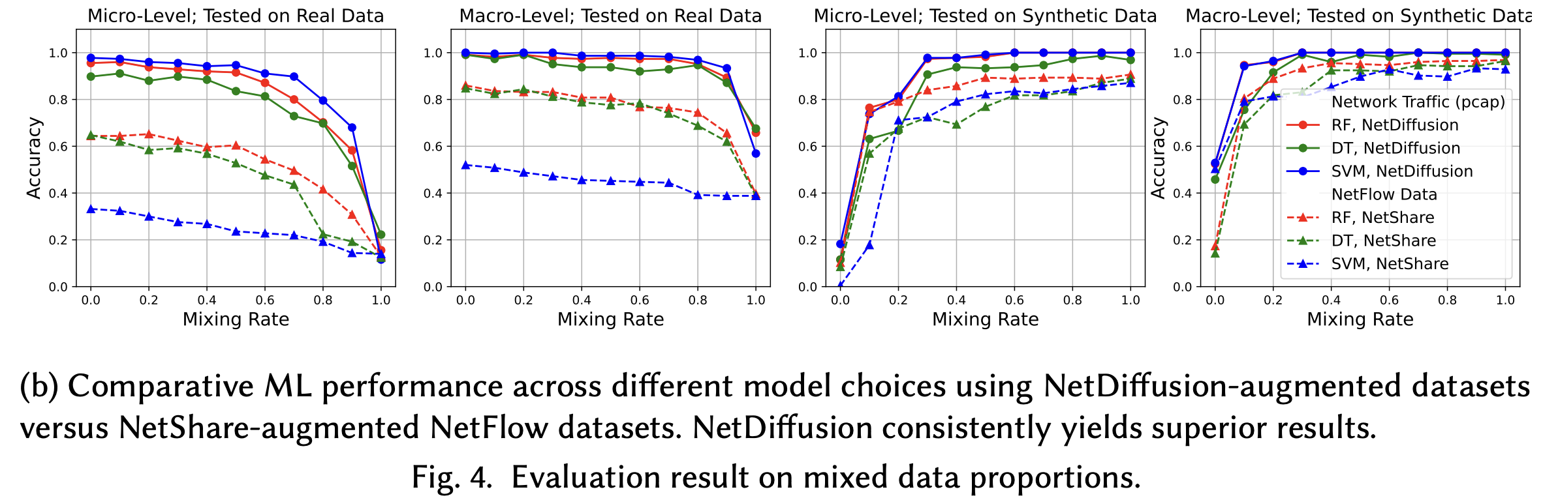
Evaluation
Analysis Evaluation (traffic classification accuracy):
Notes:
We then look at the scenarios where the training is done using a mixture of both real and synthetic data by gradually replacing proportions of the real training data with the synthetic data, and across all scenarios, ML models that use our synthetic data is able to outperform those that use the baseline synthetic data.

Slide 47
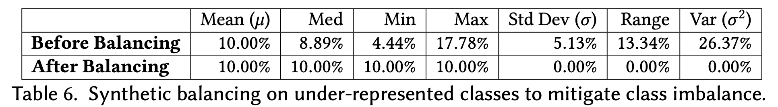
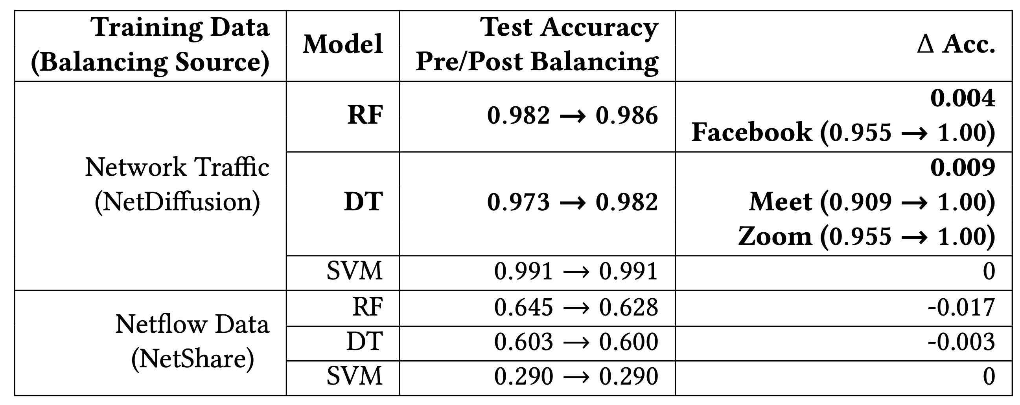
Evaluation
Analysis Evaluation (traffic classification accuracy – class balancing):
Notes:
Last we look at the case where we try to use synthetic data to solve the problem of class imbalance. Here we populate under represented classes using the synthetic data points until these classes have the same number of instances as the most popular class.
1. And we can see that, the machine learning accuracy actually improves when we carry out class balancing using NetDiffusion data and for particular classes that are underrepresented such as facebook meet and zoom in this case, the classification accuracy actually improves by a significant amount as we drastically increased their presence using high quality data that resembles the real instances. Which is not necessarily the case of the baseline.

Slide 48
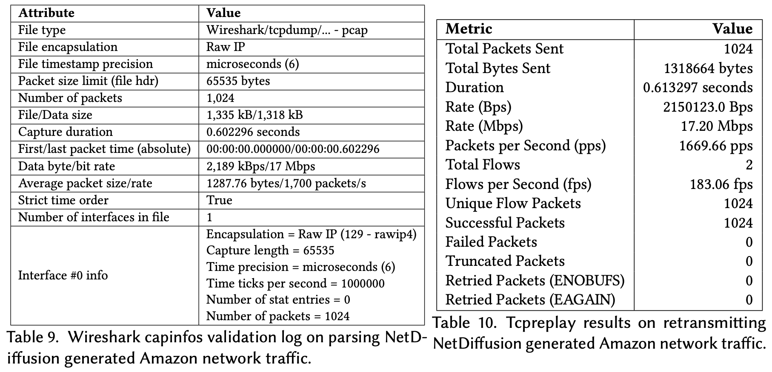
Evaluation
Analysis Evaluation (non-ML tasks):
Compatibility with WireShark and TCPReplay
Notes:
Now we look at the performance of NetDiffusion data with non-ML tasks.
1. We first verify that our data is highly compatible with both WireShark and TCPReplay with no significant errors or exceptions raised when our generated data is passed into these tools

Slide 49
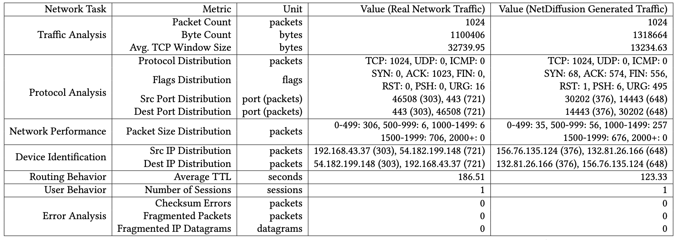
Evaluation
Analysis Evaluation (non-ML tasks):
Compatibility with WireShark and TCPReplay
Feature Extraction for Core Network Analysis Tasks
Notes:
We then survey a list of network operation tasks and show that essential metrics for these tasks can be successfully derived from our data, including tasks ranging from traffic analysis to routing behavior analysis.
As you can see that there are still certain fields such as the TCP flags that are not 100% as expected in our data, and we are actively working on these further formulating these fields by adding additional techniques such as incorporating a tcp state machine or by training from scratch a dedicated control model and constraint bounded generation and denoising steps.

Slide 50
Possibilities and Challenges
We advocate for a paradigm shift towards generation of highly-granular, protocol-compliant network traces, using a text-to-traffic diffusion model as a pilot analysis.
Context transferring
Network traffic dimensionality
Generative foundation model beyond traffic generation
Notes:
To wrap up, we show that our proposed paradigm is promising for generating these highly granular and realistic traffic data.
However there remains many challenges that are worth looking into.
1. For example, in this framework, the model's efficacy is tested only with producing already-seen traffic. Future work could explore using the prompt-based nature of text-to-image diffusion models for context transferring, for instance, if we fine-tune or train a model using TLS encrypted Youtube traffic and VPN-encrypted Netflix traffic, can we design the model in such a fashion where it can learn the VPN encryption style and produce VPN-encrypted Youtube traffic without ever seeing it.
2. Additionally, network traffic data comes with variable input/output lengths and high dimensionality which produce unique challenges. For example our current framework is limited by the image dimension which confines the image to 1024 rows of pixels, meaning 1024 packets, this highlights the need for specialized models and optimization techniques for effective traffic data synthesis. This limits not only to diffusion models but also LLMs as well where the token cap can pose constrains.
3. Lastly, it would be great if we can create a foundation model that resembles something like stable diffusion, but specifically for networking scenarios, which does not limit to traffic generation.

Slide 51
GAN-based Generations
Inter-arrival-time (IAT) Example:
Real IAT for 3 flows = [10 ms, 11 ms, 11 ms]
Average IAT across real data points = 10.67 ms
Generated IAT for 3 flows = [10.5 ms, 10.5 ms, 11 ms]
Average IAT across synthetic data points = 10.67 ms
DoppelGANger
NetShare
Notes:
For instance, when generating synthetic inter-arrival times for flows, we aim for the overall average to closely match real data, while allowing minor variations in individual data points.

Slide 52
Original Eval in NetShare
Original:
Generator Training Dataset | Features Used | Generation Method | Avg. Accuracy
TON (Anomaly Detection) | All produced features | NetShare | ~ 0.60
 |  | CTGAN | ~ 0.50
 |  | STAN | ~ 0.40
 |  | E-WGAN-GP | ~ 0.10
Our Evaluation:
Generator Training Dataset | Features Used | Generation Method | Avg. Accuracy (service: 3-class) | Avg. Accuracy (application: 10-class)
Service/Application Traffic | All produced features (excluding IPs, ports) | NetShare | 0.42 | 0.2
 |  | Ours | 0.72 | 0.31

Slide 53
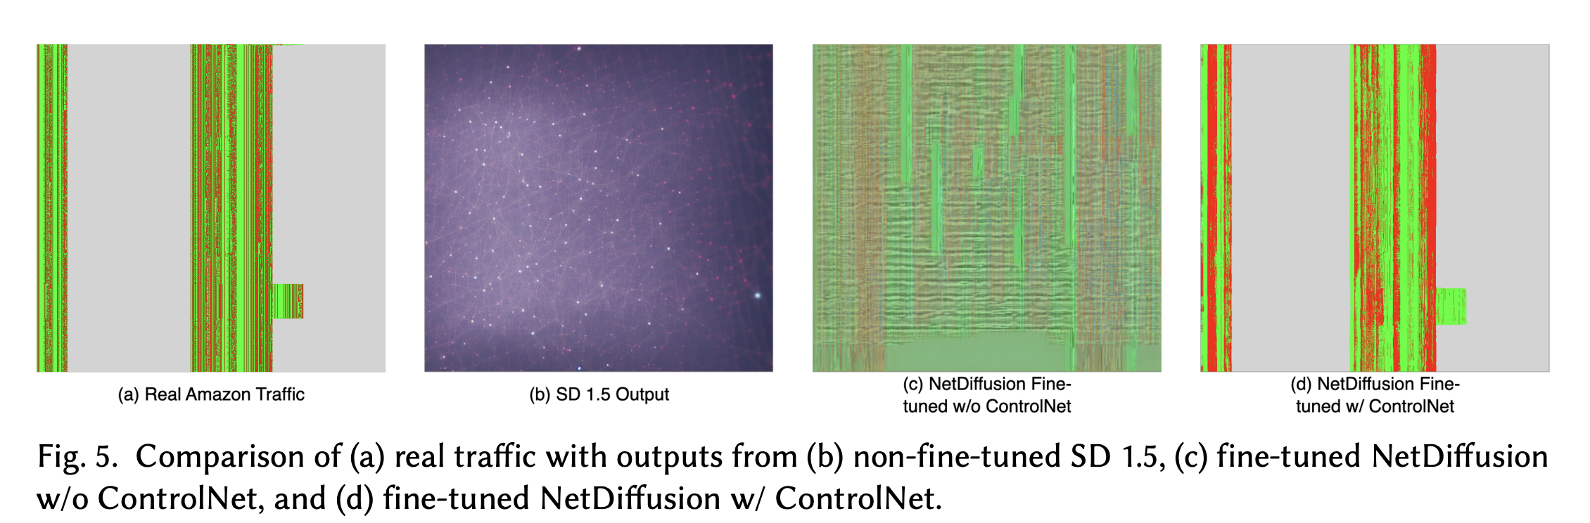
Evaluation (Ablation)

